Slide 1
Convolution

Slide 2
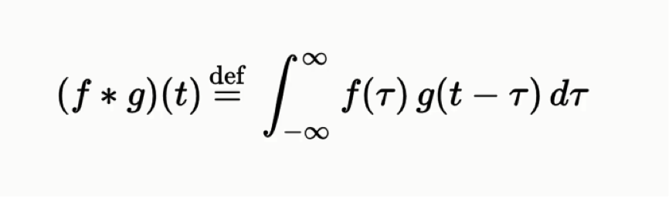
Convolution

Slide 3
Convolution Layer — The Kernel Convoluting a 5x5x1 image with a 3x3x1 kernel to get a 3x3x1 convolved feature

Slide 4
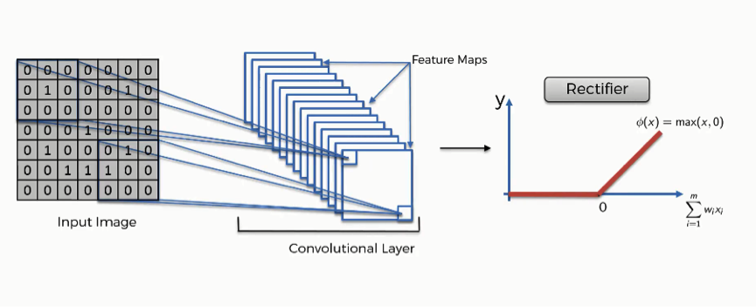
ReLU layer We use ReLU layer to increase non linearaty. In our cnn or image

Slide 5
Pooling Layer
Pooling layer is responsible for reducing the spatial size of the Convolved Feature.
This is to decrease the computational power required to process the data through dimensionality reduction.
It is useful for extracting dominant features which are rotational and positional invariant.

Slide 6
Types of Pooling
1.Max Pooling
2. Average Pooling
Max Pooling returns the maximum value from the portion of the image covered by the Kernel.
Average Pooling returns the average of all the values from the portion of the image covered by the Kernel.
Max Pooling also performs as a Noise Suppressant.
Average Pooling simply performs dimensionality reduction.
Max Pooling performs a lot better than Average Pooling.

Slide 7
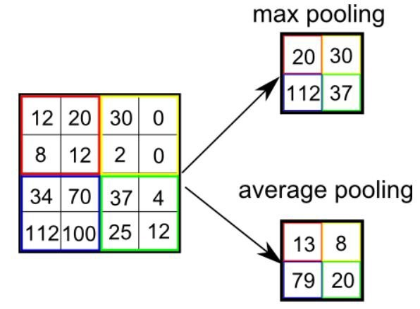
Max Pooling , Average Pooling

Slide 8
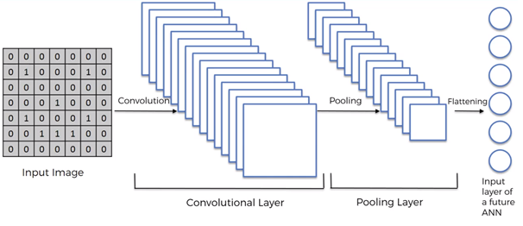
Flattening

Slide 9
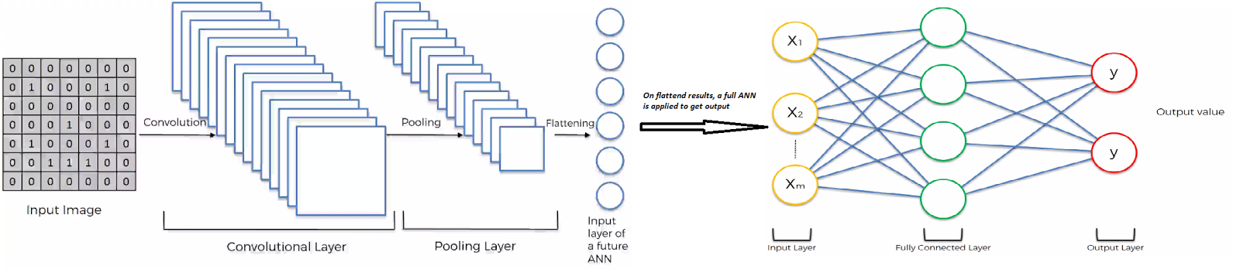
Classification — Fully Connected Layer (FC Layer)

Slide 10

Activation Function
Activation functions are an extremely important feature of the artificial neural networks. They basically decide whether a neuron should be activated or not.
Activation Function calculates a “weighted sum” of its input, adds a bias and then decides whether it should be “fired” or not.
It simply adds non-linearity to the network.

Slide 11
Activation Function
Any neuron (except input layer neurons) calculates the weighted sum of inputs, adds some bias and then applies activation function to it.
Without the activation function network is similar to a linear regression model which can only address the linear relationship between variables.
A model with limited power and not suitable for complex problems like image classifications, object detections, language translations, etc.

Slide 12
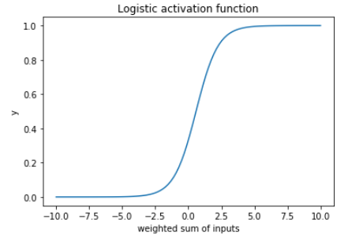

Sigmoid Function (Logistic Activation Function)

Slide 13
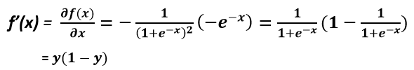
Sigmoid Function
It ranges from 0 to 1.
The derivative of an activation function helps in calculation during backpropagation.
During backpropagation, the derivative of loss w.r.t parameter is calculated.

Slide 14
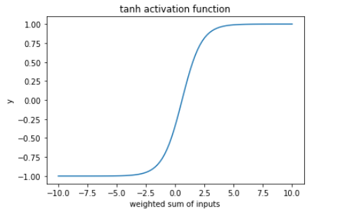
Tanh (Hyperbolic tangent)

Slide 15

Tanh (Hyperbolic tangent)
It is similar to logistic activation function with a mathematical equation
The output ranges from -1 to 1 and having an equal mass on both the sides of zero-axis so it is zero centered function.

Slide 16
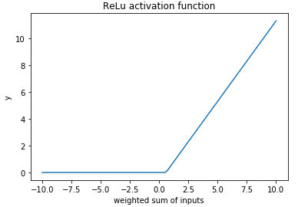
ReLu (Rectified linear units)

Slide 17


ReLu (Rectified linear units)
If the input is a positive number the function returns the number itself and if the input is a negative number then the function returns 0.

Slide 18

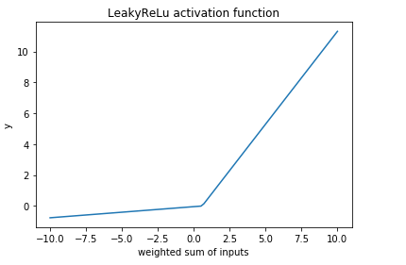
Leaky ReLu

Slide 19

Leaky ReLu
It was proposed to fix the dying neurons problem of ReLu.
It introduces a small slope to keep the update alive for the neurons where the weighted sum of inputs is negative.

Slide 20

Softmax activation function
The softmax activation function is a type of sigmoid function.
For a binary classification problem, the logistic activation function works well but not for a multiclass classification problem.
Softmax is generally preferred in the output layer where we are trying to get probabilities for different classes in the output.

Slide 21
Summery
For CNN, ReLu is treated as a standard activation function but if it suffers from dead neurons then switch to LeakyReLu.
Always remember ReLu should be only used in hidden layers.
For classification, Sigmoid functions(tanh, Softmax) and their combinations work well.
For RNN, the tanh activation function is preferred as a standard activation function.

